Slide 1

FAKE NEWS DETECTION USING AI
TEAM MEMBERS:
Pranjal Goyal (18BCP082)
Priyank Shah (18BCP086)
Priya Patel (18BCP085)
Priyanka Yadav (18BCP087)
Pratvi Shah (18BCP083)

Slide 2
INTRODUCTION TO THE PROBLEM STATEMENT
Fake news is fake or misleading information presented as news or say Fake News may be a spread of disinformation and hoaxes through any news platform. It often has the aim of damaging the reputation of an individual or entity or making money through advertising revenue.
The approaching threat of such widespread misinformation is clear and hence we'll check out ways during which such Fake News are often identified with the assistance of AI. Fake News Detection and analysis is an open challenge in the field of AI!

Slide 3
TYPES OF FAKE NEWS
FAKE NEWS ARTICLE
CLICKBAIT

Slide 4
FAKE NEWS ARTICLE
We are defining “Fake News Article” as those news stories/articles that are false: the story/article itself is fabricated, with no verifiable facts, sources or quotes.
Some fake articles have relatively frequent use of terms seemingly intended to inspire outrage and the present writing skill in such articles is generally considerably lesser than in standard news.

Slide 5
CLICKBAIT
Clickbait is defined as content whose main purpose is to draw attention and encourage visitors to click on a link to a specific website.
Clickbait may be a text or a thumbnail link that's designed to draw in attention and to entice users to follow that link and skim, view, or hear the linked piece of online content, with a defining characteristic of being deceptive, typically sensationalized, or misleading.

Slide 6
DATASET
Here, in our project, we are mainly using 2 datasets each for “Fake News Article” and “Clickbait”. Data is collected by scraping the websites of popular news publishing sources. (Kaggle)
The collected news articles are judged using the score, quality, bias as metrics collected from PolitiFact and Media Charts.

Slide 7
DATASET ATTRIBUTES
The clickbait dataset contains, only two attributes:
Tagline: The main heading of the content
ClickBait: (0 or 1) weather the given news in clickbaited or not.
The Fake news articles contains 6 attributes, the main attributes are:
Title: Title of the article.
Text: Content of the news article
Label: Indicates news article is fake or not

Slide 8
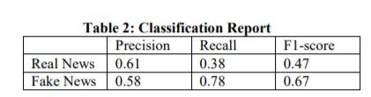
Literature Survey
Fake News:
1) Kumar, A., Singh, S., & Kaur, G. (2019). Fake News Detection of Indian and United States Election Data using Machine Learning Algorithm. International Journal of Innovative Technology and Exploring Engineering (IJITEE), 8(11), 1559-1563.
The results of Linear Regression performed by Training with US dataset. The Precision, Recall, F1-score can be seen which gave the accuracy score of 59 % according to the IJITEE.
The dataset used by IJITEE , the first data has been collected from kaggle repository which focuses on US-based presidential election.. In this research include (6335 X 3), which means 6335 rows and three columns.
The classification report is as follows:

Slide 9
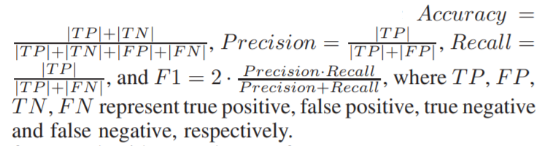
Literature Survey
Fake News:
2) Shu, K., Wang, S., & Liu, H. (2017). Exploiting Tri-Relationship for Fake News Detection. arXiv preprint arXiv:1712.07709.
This paper explored the correlations of publisher bias, news stance, and relevant user engagements simultaneously, and propose a Tri-Relationship Fake News detection framework (TriFN).
To evaluate the performance of fake news detection algorithms, we use the following metrics, which are commonly used to evaluate classifiers in related areas.
TriFN achieves average relative improvement of 9.23%, 8.48% on BuzzFeed and 6.94%, 8.24% on PolitiFact, comparing with LIWC+Castillo in terms of Accuracy and F1 score.

Slide 10
Literature Survey
ClickBait:
1) Potthast, M., Köpsel, S., Stein, B., & Hagen, M. (2016). Clickbait Detection. Advances in Information Retrieval, 810–817. doi:10.1007/978-3-319-30671-1_72
Potthast at el. split their own sample Twitter corpus into datasets for training and testing at a 2:1 training-test ratio.
Their clickbait detection model is based on 215 features, and those features are divided into three categories pertaining to (1) the teaser message, (2) the linked web page, and (3) meta information.
They apply and compare the three well-known learning algorithms logistic regression, naive Bayes, and random forest using default parameters.
After comparison, they developed a clickbait model based on 215 features that enables a random forest classifier to achieve 0.76 precision and 0.76 recall.

Slide 11
Literature Survey
ClickBait:
2) Zuhroh, N. A., Rakhmawati, N. A.(2019). Clickbait detection: A literature review of the methods used. Scientific Journal of Information System Technology, 6(1), 1-10. DOI:10.26594/register.v6i1.1561
There is a need for a literature review to determine various previous methods and approaches. Therefore, this literature review 1) provides a summary of the earlier methods used, and 2) analyzes several methods and previous research.
The researcher identified several detection steps from the literature. These include (1) Collection of clickbait and non-clickbait news articles from several social media and sites, with labeling initially carried out manually by several volunteers. (2) Data preprocessing in the form of cleaning. (3) Analysis of feature selection. (4) Its classification, which explains the techniques used in clickbait detection.
The 21 literature studies showed that clickbait is detected using a machine learning classification algorithm with deep learning and neural network approaches. Therefore, machine learning-based research often uses the Random Forest algorithm, while deep and neural network makes use of CNN, BiLSTM, BiGRU, and Multilayer Perceptron.

Slide 12
Proposed Methodology
Fake News Detection:
LSTM(Long short-term memory): It is a type of recurrent neural network capable of learning order dependence in sequence prediction problems.
For the corpus part the input text was cleaned and pre-processed and then it was converted to one hot encoding and after that we applied padding sequences so that inputs that have the same shape and size.
The train-test split was 70:30.
Clickbait Detection :
Firstly cleaning and pre-processing of the dataset was done by removing stop words,punctuation marks and null rows.
Multinomial NB, Logistic Regression, Random Forest and Passive Aggressive models were used with TF-IDF Vectorizer and the best performing model, Multinomial NB was used for the website.
The train-test split was 80:20.

Slide 13
Results
The LSTM model used for prediction of Fake news have an accuracy of 92.7%.
Multinomial NB model with TF IDF Vectorizer used for prediction of Clickbait has an accuracy of 96.7%. Other models (with TF IDF) were with accuracy:
Model | Accuracy
Multinomial NB model | 96.7%
Logistic Regression model | 94.9%
Random Forest model | 92.1%
Passive Aggressive model | 96.1%

Slide 14
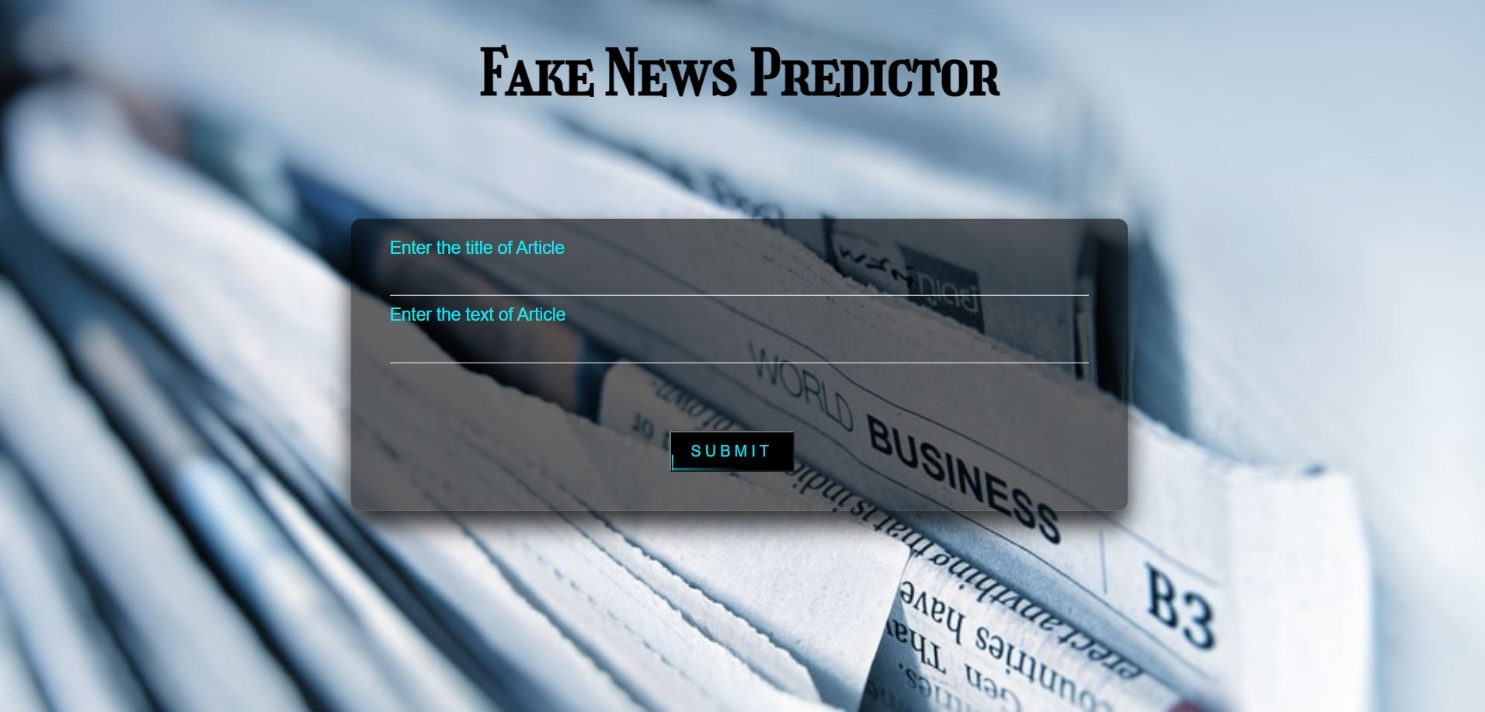
Website Implementation
HomePage:

Slide 15
FUTURE SCOPE
Here, in our project, we are mainly focusing on the type “Fake News Article” but in near future if there is a need to expand this project then we can work on types of fake news like “Political Fake News.” Since Dataset of Indian Political Fake News is not available currently.
The model can be further optimized by using Bi-directional LSTM model for the Fake News Detection.
Also, further this project can be extended by using the datasets of fake news from WhatsApp or twitter or other sources. This would a sort of Plugin we can install in whatsapp and other social media platforms.

Slide 16
References:
Fake News DataSet:
(https://www.kaggle.com/c/fake-news/data?select=train.csv)
ClickBait Dataset:
(https://www.kaggle.com/amananandrai/clickbait-dataset)
Research Paper:
Fake News :
https://www.ijitee.org/wp-content/uploads/papers/v8i11/K18290981119.pdf
https://link.springer.com/chapter/10.1007%2F978-981-15-8354-4_26
https://cutt.ly/Fbdhm1J
Clickbait:
https://link.springer.com/chapter/10.1007/978-3-319-30671-1_72
https://cutt.ly/2bdhA9p

Slide 17
Thank You!
https://docs.google.com/presentation/d/1Dg91dsjLGi5x-FYmf-SwO9Q49WNAHhOOb3Ddf3jBHsI/edit?usp=sharing

